Slide 1
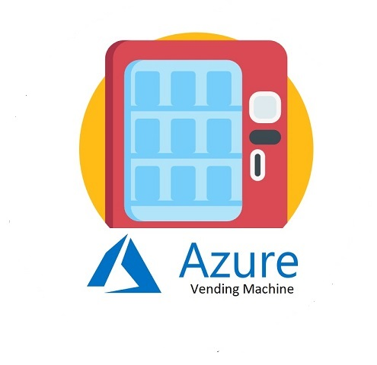
Azure Vending Machine
An Easy Application to help any non-IT users to order VM from Azure without having IT knowledge

Slide 2
What’s your hack project story?
Where did the idea come from? (very briefly)
>> I have got lot of complaint around Azure portal is hard to use from non-IT unit in many company. So want something that easy enough for non-IT people to be able to use our Azure platform.
Why do you care about this idea/area?
>> It can become the alternative app to help non-IT people to adopt our platform more
How does this relate to your day jobs, if at all?
>> It helps generating ACR for Azure, It helps adoption in Power Platforms and also help customer to use our Modern workplace platform in one go
Notes:
Note: Don’t spend too much time on the “set-up” or problem statement. Viewers usually pick that up quickly, and they want to get to hearing about your project/solution.

Slide 3
Primary customer
Any Non-IT users in any organizations

Slide 4
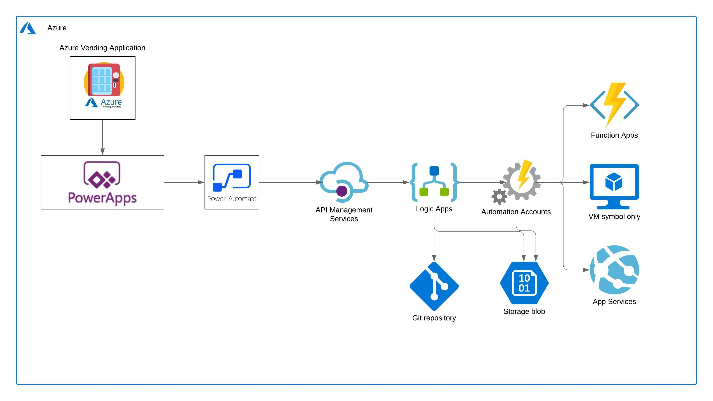
How does it work?

Slide 5
DEMO
Prototype
Application

Slide 6
Impact for the Customer
Why is this solution different and compelling for the customer?
>> The full app can help business utilize Azure platform directly without the prior knowledge on how to create “VM” , How to setup VNET, How to apply Security
They can also reduce the time on the paperwork which required to be submitted when asking for resource from IT team

Slide 7
Impact for Microsoft
Why are you participating in a Hackathon?
>> I would like to add one more idea into the community and try to solve the challenge one at a time
Why did you choose a career at Microsoft?
>> I have Bill Gates as my idol. So I would like to work in the company that has passion to solve the challenge of humanity
How you envision the impact of your hack
>> I hope that with my prototype here I can make all sellers at Microsoft realize that our end-to-end platform is the best! We can help our customers in many way with the tools that we have.

Slide 8
Thank you!

